Slide 1
Recommendation Systems using Python
Aiproff.ai

Slide 2
RoadMap
Introduction
What are recommendation engines?
How does a recommendation engine work?
Data collection
Data storage
Filtering the data
Content Based Filtering
Collaborative Filtering
Collaborative Filtering with User-User Method
Collaborative Filtering with Item-Item Method
Matrix Factorization
Singular value decomposition
Alternating Least Squares
Hybrid Recommendation System
Neural Collaborative Filtering
© 2023 AiProff.ai

Slide 3
What are Recommendation Engines?
Until recently, individuals typically preferred purchasing items suggested by their friends or those they trust.
This was the go-to approach for making a purchase, especially when uncertainties about a product existed.
However, in this digital era, the landscape has evolved to encompass online platforms employing recommendation engines.
It is the conscious and unconscious choices that we make, become a potential indicator of what would be our next choice
These engines sift through data employing various algorithms to suggest the most pertinent items to users. They begin by analyzing a customer's previous behavior and, using that information, propose products that align with the user's potential preferences for purchase.
© 2023 AiProff.ai

Slide 4
What are Recommendation Engines?
When a completely new user explores an e-commerce site, the site lacks any prior history of that user.
So, how does the site approach in suggesting products in such a situation? One potential solution involves recommending the best-selling products, those in high demand.
Alternatively, the site might suggest products that would generate maximum profit for the business.
By offering tailored recommendations based on a customer's needs and interests, a positive impact on user experience is achieved, fostering repeated visits.
Consequently, contemporary businesses are investing in the development of intelligent recommendation engines, leveraging insights from the past behavior of their users.
Now that we've gained an understanding of recommendation engines, let's delve into how they operate.
© 2023 AiProff.ai

Slide 5
How does a recommendation engine work?
Before delving into the intricacies of this topic, let's explore some plain vanilla approaches for recommending items to users:
Recommending items based on overall popularity among all users.
2. Segmenting users based on their preferences (user features) and tailoring recommendations according to the segment they belong to.
Both methods have their drawbacks. In the first case, everyone sees the same recommendations as the most popular items remain constant for all users. In the second case, with an increasing number of users, handling a growing number of features becomes a challenging task.
The core issue here is the inability to customize recommendations according to individual user interests.
It's akin to Amazon suggesting a laptop solely because it's a popular choice among the majority of shoppers.
Companies like Amazon don't rely on such approaches. Instead, they employ personalized methods that enhance the accuracy of product recommendations.
So how do we improve on this ?
© 2023 AiProff.ai

Slide 6
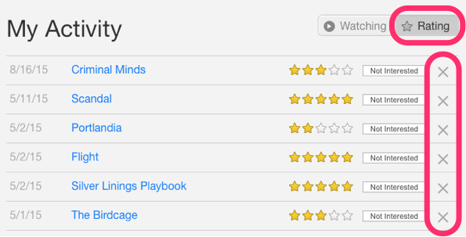
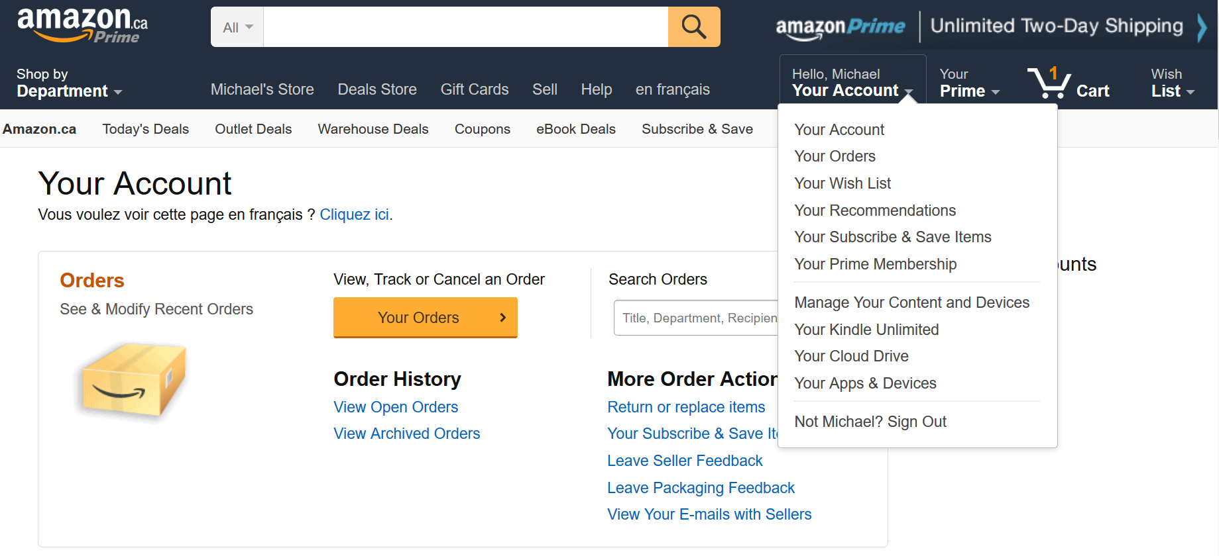
Data Collection
This is the first and most crucial step for building a recommendation engine. The data can be collected by two means: explicitly and implicitly. Explicit data is information that is provided intentionally, i.e. input from the users such as movie ratings. Implicit data is information that is not provided intentionally but gathered from available data streams like search history, clicks, order history, etc.
a. Netflix is collecting the data explicitly in the form of ratings given by user to different movies.
b. The order history of a user is recorded by Amazon which is an example of implicit mode of data collection.
© 2023 AiProff.ai

Slide 7
Data Storage
The amount of data dictates how good the recommendations of the model can get.
For example, in a movie recommendation system, the more ratings users give to movies, the better the recommendations get for other users.
The type of data plays an important role in deciding the type of storage that has to be used.
This type of storage could include a standard SQL database, a NoSQL database or some kind of object storage
© 2023 AiProff.ai

Slide 8
Filtering the data
After collecting and storing the data, we have to filter it so as to extract the relevant information required to make the final recommendations.
There are various algorithms that help us make the filtering process easier.
1. Content based filtering
2. Collaborative filtering
Let’s go through each algorithm in detail.
© 2023 AiProff.ai

Slide 9
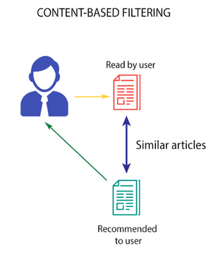
Content based filtering
This algorithm recommends products which are similar to the ones that a user has liked in the past.
For example, if a person has liked the movie “Inception”, then this algorithm will recommend movies that fall under the same genre. But how does the algorithm understand which genre to pick and recommend movies from?
Consider the example of Netflix. They save all the information
related to each user in a vector form. This vector contains the
past behavior of the user, i.e. the movies liked/disliked by the
user and the ratings given by them. This vector is known as
the profile vector. All the information related to movies is stored
in another vector called the item vector. Item vector contains the
details of each movie, like genre, cast, director, etc.
© 2023 AiProff.ai

Slide 10
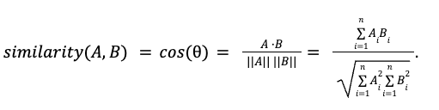
Content based filtering
The content-based filtering algorithm finds the cosine of the angle between the profile vector and item vector, i.e. cosine similarity.
For two vectors in two dimensions(i ,j) –
A=x1i+y1j
B=x2i+y2j
Dot product is defined as (x1*x2+y1*y2)
Magnitude is defined as |A|= sqrt(x1^2+y1^2)
|B|=sqrt(x2^2+y2^2)
Based on the cosine value, which ranges between -1 to 1, the movies are arranged in descending order and one of the two below approaches is used for recommendations:
Top-n approach: where the top n movies are recommended (Here n can be decided by the business)
Rating scale approach: Where a threshold is set and all the movies above that threshold are recommended
© 2023 AiProff.ai

Slide 11

Content based filtering
Other methods that can be used to calculate the similarity are:
Euclidean Distance: Similar items will lie in close proximity to each other if plotted in n-dimensional space. So, we can calculate the distance between items and based on that distance, recommend items to the user. The formula for the euclidean distance is given by:
Pearson’s Correlation: It tells us how much two items are correlated. Higher the correlation, more will be the similarity. Pearson’s correlation can be calculated using the following formula:
© 2023 AiProff.ai

Slide 12
Content based filtering
A major drawback of this algorithm is that it is limited to recommending items that are of the same type.
It will never recommend products which the user has not bought or liked in the past.
So if a user has watched or liked only action movies in the past, the system will recommend only action movies.
It’s scope is relatively narrow.
To improve on this type of system, we need an algorithm that can recommend items not just based on the content, but the behaviour of users as well.
Lets clone the github repo and follow the steps of README.md file
© 2023 AiProff.ai

Slide 13
Collaborative filtering
Let us understand this with an example.
If person A likes 3 movies, say Interstellar, Inception and Predestination, and person B likes Inception, Predestination and The Prestige, then they have almost similar interests.
We can say with some certainty that A should like The Prestige and B should like Interstellar.
The collaborative filtering algorithm uses “User Behavior” for recommending items.
This is one of the most commonly used algorithms in the industry as it is not dependent on any additional information.
There are primarily two types of collaborating filtering techniques as explained next.
© 2023 AiProff.ai

Slide 14
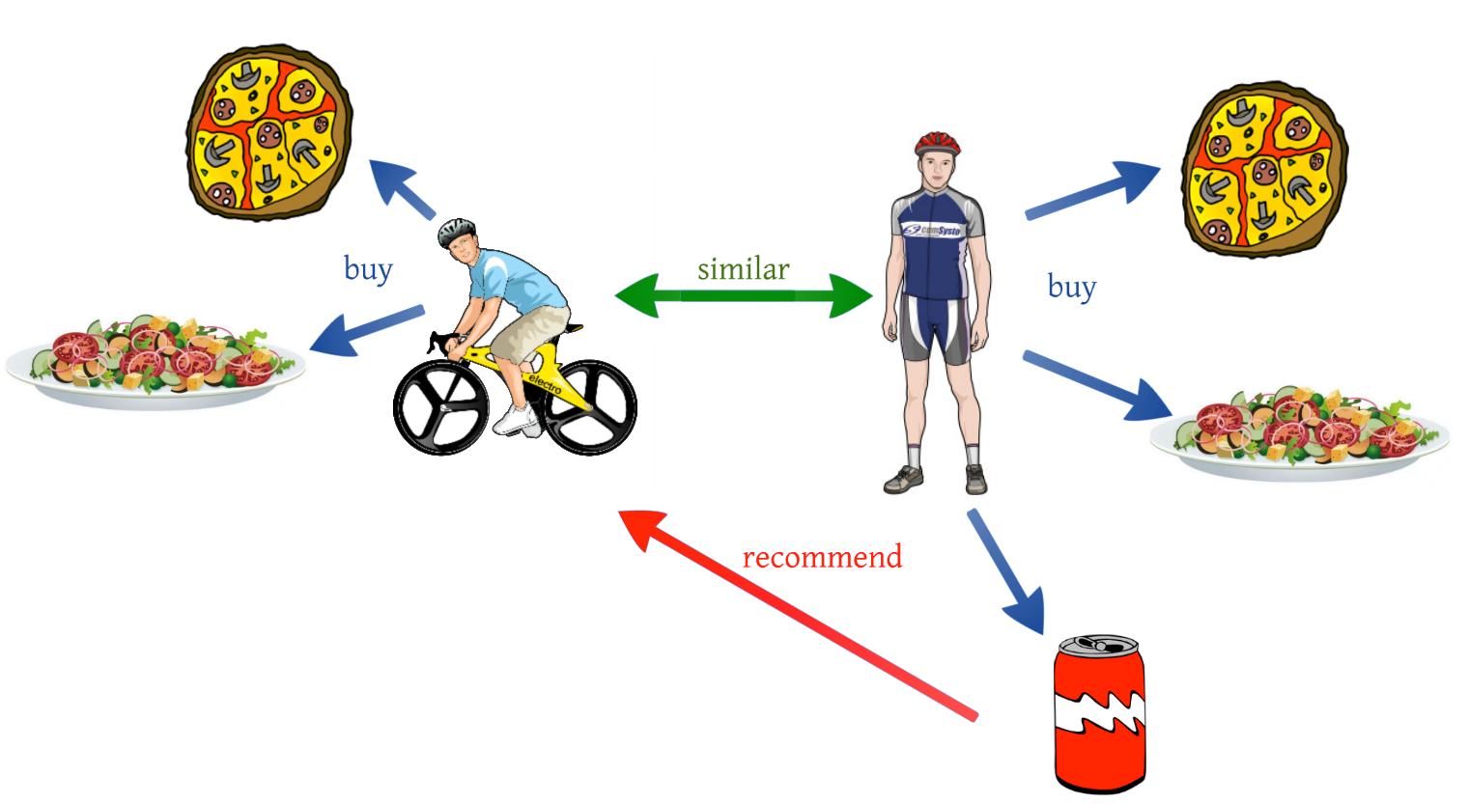

Collaborative filtering - User-User collaborative filtering
This algorithm first finds the similarity score between users. Based on this similarity score, it then picks out the most similar users and recommends products which these similar users have liked or bought previously.
In terms of our movies example from
earlier, this algorithm finds the similarity
between each user based on the ratings
they have previously given to different
movies. The prediction of an item for a
user u is calculated by computing the
weighted sum of the user ratings given
by other users to an item i.
The prediction Pu,i is given by:
Here,
P_{u,i} is the prediction of an item
R_{v,i} is the rating given by a user v to a movie i
S_{u,v} is the similarity between users
© 2023 AiProff.ai

Slide 15
Collaborative filtering - User-User collaborative filtering
Now, we have the ratings for users in profile vector and based on that we have to predict the ratings for other users. Following steps are followed to do so:
For predictions we need the similarity between the user u and v. We can make use of Pearson correlation.
First we find the items rated by both the users and based on the ratings, correlation between the users is calculated.
The predictions can be calculated using the similarity values. This algorithm, first of all calculates the similarity between each user and then based on each similarity calculates the predictions. Users having higher correlation will tend to be similar.
Based on these prediction values, recommendations are made. Let us understand it with an example:
© 2023 AiProff.ai

Slide 16

Collaborative filtering -
User-User collaborative filtering
Consider the user-movie rating matrix:
User/Movie x1 x2 x3 x4 x5 Mean User Rating
A 4 1 – 4 – 3
B – 4 – 2 3 3
C – 1 – 4 4 3
Here we have a user movie rating matrix. To understand this in a more practical manner, let’s find the similarity between users (A, C) and (B, C) in the above table. Common movies rated by A and C are movies x2 and x4 and by B and C are movies x2, x4 and x5
The correlation between user A and C is more than the correlation between B and C. Hence users A and C have more similarity and the movies liked by user A will be recommended to user C and vice versa
© 2023 AiProff.ai

Slide 17
Collaborative filtering - User-User collaborative filtering
This algorithm is quite time consuming as it involves calculating the similarity for each user and then calculating prediction for each similarity score. One way of handling this problem is to select only a few users (neighbors) instead of all to make predictions, i.e. instead of making predictions for all similarity values, we choose only few similarity values. There are various ways to select the neighbors:
* Select a threshold similarity and choose all the users above that value
* Randomly select the users
* Arrange the neighbors in descending order of their similarity value and choose top-N users
* Use clustering for choosing neighbors
This algorithm is useful when the number of users is less. Its not effective when there are a large number of users as it will take a lot of time to compute the similarity between all user pairs. This leads us to item-item collaborative filtering, which is effective when the number of users is more than the items being recommended.
© 2023 AiProff.ai

Slide 18


Collaborative filtering - Item-Item collaborative filtering
So in our case we will find the similarity between each movie pair and based on that, we will recommend similar movies which are liked by the users in the past. This algorithm works similar to user-user collaborative filtering with just a little change – instead of taking the weighted sum of ratings of “user-neighbors”, we take the weighted sum of ratings of “item-neighbors”. The prediction is given by:
Now we will find the similarity between items
© 2023 AiProff.ai

Slide 19
Collaborative filtering -Item-Item collaborative filtering
Now, as we have the similarity between each movie and the ratings, predictions are made and based on those predictions, similar movies are recommended. Let us understand it with an example
User/Movie x1 x2 x3 x4 x5
A 4 1 2 4 4
B 2 4 4 2 1
C – 1 – 3 4
Mean Item Rating 3 2 3 3 3
Here the mean item rating is the average of all the ratings given to a particular item (compare it with the table we saw in user-user filtering). Instead of finding the user-user similarity as we saw earlier, we find the item-item similarity.
To do this, first we need to find such users who have rated those items and based on the ratings, similarity between the items is calculated. Let us find the similarity between movies (x1, x4) and (x1, x5).
Common users who have rated movies x1 and x4 are A and B while the users who have rated movies x1 and x5 are also A and B.
© 2023 AiProff.ai

Slide 20

Collaborative filtering - Item-Item collaborative filtering
The similarity between movie x1 and x4 is more than the similarity between movie x1 and x5.
So based on these similarity values, if any user searches for movie x1, they will be recommended movie x4 and vice versa.
But a key challenge comes up when a completely new user need to be recommended to ?
This is called a Cold Start Problem .
There can be two types of cold start:
1. Visitor Cold Start
2. Product Cold Start
© 2023 AiProff.ai

Slide 21
Collaborative filtering – Cold Start Challenge
Visitor Cold Start means that a new user is introduced in the dataset.
Since there is no history of that user, the system does not know the preferences of that user. It becomes harder to recommend products to that user. So, how can we solve this problem?
One basic approach could be to apply a popularity based strategy, i.e. recommend the most popular products.
These can be determined by what has been popular recently overall or regionally. Once we know the preferences of the user, recommending products will be easier.
Product Cold Start means that a new product is launched in the market or added to the system.
User action is most important to determine the value of any product.
More the interaction a product receives, the easier it is for our model to recommend that product to the right user. We can make use of Content based filtering to solve this problem.
The system first uses the content of the new product for recommendations and then eventually the user actions on that product.
© 2023 AiProff.ai

Slide 22
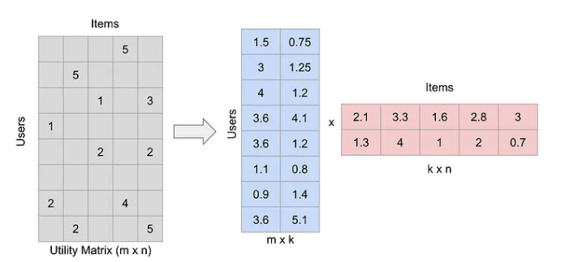
Matrix Factorization
Matrix Factorization is a technique used in recommendation systems to predict missing ratings in a user-item matrix.
This matrix, known as the utility matrix, contains ratings for each user-item pair.
Since most of these ratings are unknown initially, the matrix is typically sparse.
Matrix Factorization breaks down this large matrix into smaller ones, making it easier to predict and fill in the missing ratings.
Linear Algebra to the rescue !
© 2023 AiProff.ai

Slide 23
Singular Value Decomposition(SVD)
SVD is widely used in recommendation systems for matrix factorization.
It decomposes the user-item rating matrix to predict missing ratings and recommend items.
SVD is a method of decomposing a matrix into three other matrices:
U (Left Singular Vectors): An orthogonal matrix containing the eigenvectors of
AA^{T} , where A is the original matrix.
Σ (Singular Values): A diagonal matrix with non-negative diagonal elements known as singular values, which are the square roots of the eigenvalues of
A^{T}A or AA^{T}
V^{T} (Right Singular Vectors): The transpose of an orthogonal matrix containing the eigenvectors of A^{T}A.
The decomposition is given by:
A= UΣV^{T}
© 2023 AiProff.ai

Slide 24
Singular Value Decomposition(SVD)
SVD decomposes a matrix into three matrices: user, singular values, and item.
Reduces dimensionality, capturing significant latent factors.
Approximates collaborative filtering, enabling personalized recommendations.
Identifies hidden features, revealing underlying user-item relationships.
Enhances prediction accuracy for unrated items based on learned patterns.
Filters noise, effective for sparse matrices, and handles sparse data.
Enables matrix reconstruction, understanding the contribution of latent factors.
Regularized SVD prevents overfitting, improving generalization.
© 2023 AiProff.ai

Slide 25
Singular Value Decomposition(SVD)
Widely used in image compression, representing images with reduced factors.
Computational challenges addressed with approximate methods like Truncated SVD.
Interpretation of latent factors may require domain knowledge.
Adaptable foundation for advanced collaborative filtering techniques.
© 2023 AiProff.ai

Slide 26
Singular Value Decomposition(SVD) – Simple Example
#Importing Libraries.
import numpy as np
#Creating a matrix A
A = np.array([[4,4,3],[1,4,3],[4,8,1]])
#Performing SVD
U, S, VT = np.linalg.svd(A)
print(A)
[[4 4 3]
[1 4 3]
[4 8 1]]
#Printing the shape of each matrix.
print(A.shape)
print(U.shape)
print(S.shape)
print(VT.shape)
(3, 3)
(3, 3)
(3,)
(3, 3)
© 2023 AiProff.ai

Slide 27
Singular Value Decomposition(SVD)
- Some research combines item similarity with SVD to overcome the cold start problem.
- Prediction with SVD involves calculating cosine similarities between pseudo-users and pseudo-items.
- Prediction score P_{i,j} for user i on item j is computed by adding the row average R_{i} to the similarity.
- SVD decomposition completion makes prediction generation time constant.
- Successful SVD variants include FunkSVD, SVD++, Regularized SVD, and Iterative SVD.
We will use Google Colab to install libraries and run SVD algorithm
### Refer to the updated code called SVD_updated.ipynb
© 2023 AiProff.ai

Slide 28
Singular Value Decomposition(SVD)
The strength of SVD lies in its ability to create connections between items based on a set of factors using Linear Algebra.
Well , if it is that good why not use it for every use case ?
Challenge: ??
© 2023 AiProff.ai

Slide 29
Unavailability of Explicit Feedback
Understanding Implicit Feedback
Implicit feedback differs from explicit feedback in several key ways:
Binary vs. Graded: Implicit feedback is often binary (e.g., item was clicked or not) or frequency-based (e.g., number of times an item was viewed), as opposed to the graded nature of explicit ratings.
Positive-Only Feedback: Implicit feedback usually only indicates positive interactions (user viewed an item) without negative feedback (user disliked an item).
Confidence Levels: The absence of an interaction does not necessarily mean a user dislikes an item, leading to uncertainty. Thus, confidence levels are associated with observations.
© 2023 AiProff.ai

Slide 30
Alternating Least Squares with Implicit Feedback
Modeling Implicit Feedback
The model is built upon the assumption that the preference of a user for an item is a latent feature. The goal is to predict this hidden preference from the observed implicit feedback.
The observed data is a matrix where entries typically represent the frequency of interaction, like the number of times a user played a song.
Confidence Levels
A confidence level is assigned to each observation, indicating how certain the model is about a user’s preference. It's usually higher for items with more interactions.
A common approach is to use a linear or logarithmic function to assign confidence levels based on interaction frequency.
Objective Function
The objective function in ALS with Implicit Feedback is modified to incorporate the confidence levels. It aims to minimize the weighted sum of squared differences between predicted and observed preferences, where weights are the confidence levels.
Regularization terms are added to prevent overfitting.
Alternating Optimization
Similar to traditional ALS, the optimization alternates between fixing the user factors and solving for item factors, and vice versa.
This is done iteratively until convergence or for a fixed number of iterations.
© 2023 AiProff.ai

Slide 31
Alternating Least Squares with Implicit Feedback
Algorithm Workflow
Initialization: Initialize the user and item matrices with random values.
User Step: Fix the item matrix and solve for the user matrix. This involves solving a least-squares problem, weighted by confidence levels.
Item Step: Fix the user matrix and solve for the item matrix, again using a weighted least-squares approach.
Repeat: Alternate between the user and item steps until the algorithm converges or reaches a predefined number of iterations.
Advantages and Applications
Scalability: ALS with Implicit Feedback is highly scalable and can handle large datasets efficiently.
Handling Sparse Data: This method is effective in dealing with the sparsity of implicit feedback data.
Wide Applicability: It’s suitable for a variety of applications where explicit feedback is not available, such as e-commerce (product views, purchases), media streaming (song plays, video watches), and content platforms (article reads, clicks).
© 2023 AiProff.ai

Slide 32
Alternating Least Squares- implicit feedback
Alternating Least Squares (ALS): This is a type of collaborative filtering algorithm used in recommendation systems. It works by alternately solving two least squares problems to estimate the user and item matrices. The goal is to minimize the difference between the actual ratings and the predicted ratings.
Implicit Feedback: Unlike explicit feedback where users rate items directly, implicit feedback involves observing user behavior to infer their preferences. For example, if a user views an item but doesn't rate it, it could be inferred that they have a positive preference for that item.
Matrix Factorization: ALS is a matrix factorization technique. It breaks down the user-item interaction matrix into two lower dimensionality rectangular matrices. One matrix represents the users and the other represents the items. Each row in these matrices corresponds to a user or an item, and each column corresponds to a latent factor.
Iterative Process: ALS operates in an iterative manner. In each iteration, it updates the user matrix and then the item matrix, and vice versa. This process continues until the error between the actual and predicted ratings falls below a certain threshold.
Predicting Ratings: Once the user and item matrices are estimated, new ratings can be predicted by taking the dot product of the corresponding rows in the user and item matrices.
Handling Cold Start Problem: ALS can struggle with the cold start problem, which is the difficulty of making recommendations for new users or items with little to no data. Techniques like adding a bias term or using content-based methods can help mitigate this issue.
© 2023 AiProff.ai

Slide 33
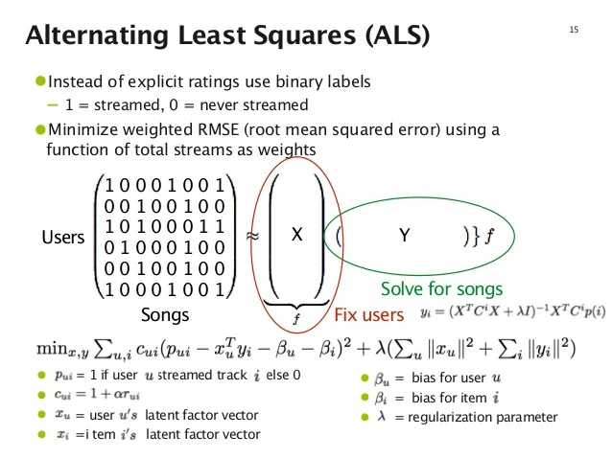
Alternating Least Squares- implicit feedback
Alternating Least Squares (ALS):
Goal: Factorizes a user-item interaction matrix to learn latent factors representing user preferences and item characteristics.
Key idea: Alternates between optimizing user factors and item factors, holding one set fixed while updating the other.
Steps for ALS with Implicit Feedback:
1. Initialize user and item latent factor matrices (U and V): Start with random values.
2. Optimize user factors (U):
Fix item factors (V).
For each user, solve a least squares problem to minimize the difference between observed interactions and predicted scores based on U and V.
3. Optimize item factors (V):
Fix user factors (U).
For each item, solve a least squares problem analogous to step 2.
4. Repeat steps 2 and 3: Iterate until convergence or a specified number of iterations.
© 2023 AIProff.ai

Slide 34
Hybrid Recommendation System – State of the Art
Hybrid Recommendation Systems combine multiple recommendation techniques to enhance prediction accuracy. They can be implemented in several ways:
1. Weighted Hybrid Systems: Assign predefined weights to each recommendation algorithm. Simple but may not always yield the best results due to fixed weights.
2. Switching Hybrid Systems: Switch between different recommendation algorithms based on certain conditions.
3. Mixed Hybrid Systems: Generate different sets of candidate datasets based on user profiles and features, then use different recommendation models to recommend items.
4. Feature Combination Hybrid Systems: Incorporate features from one recommendation model into another.
© 2023 AiProff.ai

Slide 35
Hybrid Recommendation System
Hybrid Recommendation Systems combine multiple recommendation techniques to enhance prediction accuracy. They can be implemented in several ways:
5. Feature Augmentation Hybrid Systems: Use a contributing recommendation model to generate a rating or classification of the user/item profile, which is then used in the main recommendation system.
6. Cascade Hybrid Systems: Define a strict hierarchical structure for the recommendation system. The main recommendation system produces the primary result, and a secondary model resolves minor issues in the primary result.
7. Meta-Level Hybrid Systems: Replace the original dataset with a learned model from the contributing model as the input to the main recommendation model.
In practice, hybrid systems often involve a combination of different techniques. The key is to find the balance that works best for your specific application and dataset.
© 2023 AiProff.ai

Slide 36
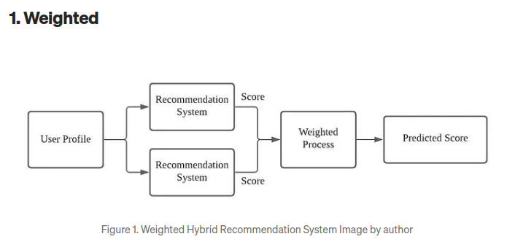
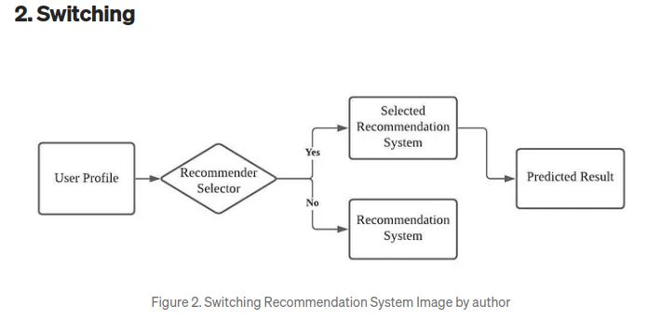
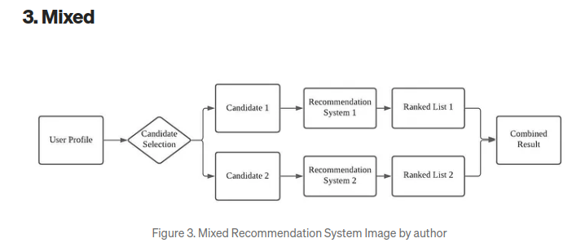
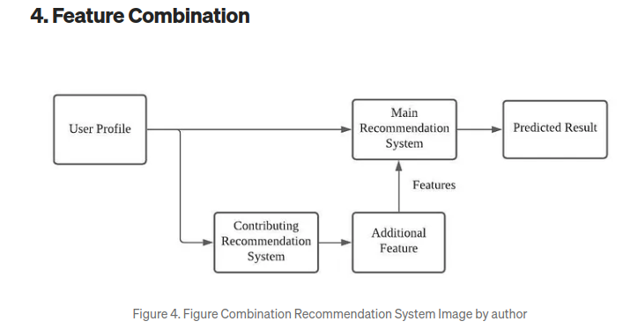
Hybrid Recommendation System
© 2023 AiProff.ai

Slide 37
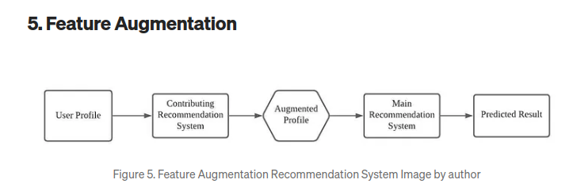
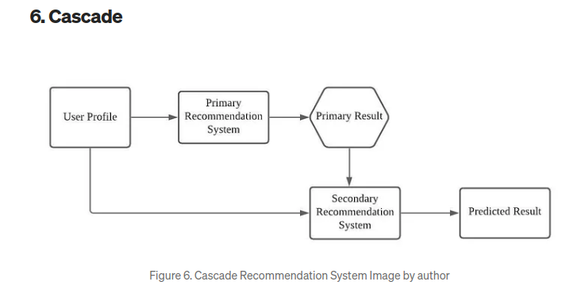
Hybrid Recommendation System
© 2023 AiProff.ai

Slide 38
Neural Collaborative Filtering
Neural Collaborative Filtering (NCF): NCF is a hybrid method combining Matrix Factorization (MF) and Deep Learning techniques. It combines the advantages of both methods to capture complex user-item interactions.
Embeddings Layer: The first layer of NCF generates meaningful embeddings for users and items. This layer has multiple embedding layers for generating embeddings for different branches of the NCF architecture
Generalized Matrix Factorization (GMF): This part captures linear relationships between users and items. It involves a simple multiplication of the User & Item embeddings matrix generated by the embedding layer
Multi-Layer Perceptron (MLP): This part of NCF captures non-linear patterns between users and items. It's a general DNN with some hidden layers that take concatenated User & Item embeddings and pass it through hidden layers with ReLU activations
Concatenation of Outputs: The outputs of the two sections (GMF and MLP) are concatenated together and a hidden layer is used before the final output. This layer where this concatenation happens is called NeuMF
© 2023 AiProff.ai

Slide 39
Neural Collaborative Filtering
Separate Embeddings: NCF uses separate embeddings for GMF and MLP. This allows the two parts to learn independently, providing more flexibility and potentially improving performance
Regularization and Initialization: To improve performance, modern NCF implementations often use different embedding initializations and regularizations. For instance, Glorot Uniform and L2 regularization are commonly used
Activation Functions: ReLU is typically used for the activation layer in the hidden layers due to its non-saturated
nature. However, the choice of activation function can vary depending on the specific implementation
© 2023 AiProff.ai

Slide 40
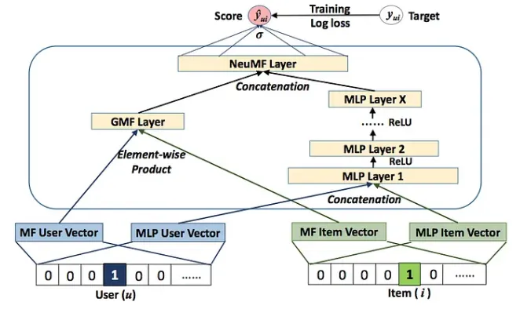
Neural Collaborative Filtering
Architecture:
© 2023 AiProff.ai

Slide 41
Neural Collaborative Filtering
The Input & Output
NCF handles one User-Item pair at a time. The input is OHE of User & Item fed separately as 2 inputs. The output is either
Expected rating the user will give to the item (if explicit feedback is used in training)
The probability the user will use the item (if implicit feedback is used).
Generalized Matrix Factorization (GMF): This section doesn’t involve any major ML complexity and is just a multiplication of the User & Item embeddings matrix generated by the embedding layer. This helps in capturing linear relationships and is similar to Matrix Factorization
Multi-Layer Perceptron (MLP): This section is a general DNN with some hidden layers that intakes concatenated User & Item embeddings and passes it through hidden layers with ReLU activations. This section helps in capturing non-linear patterns.
While merging the outputs of the two sections, they are concatenated together and a hidden layer is used before the final output. This layer where this concatenation happens is called NeuMF. This is followed by the sigmoid activation function
Embeddings + GMF + MLP + NeuMF = NCF
© 2023 AiProff.ai

Slide 42
Neural Collaborative Filtering
CODE
#pip install LibRecommender
import numpy as np
import pandas as pd
from libreco.data import random_split, DatasetPure
from libreco.algorithms import NCF # pure data,
from libreco.evaluation import evaluate
data = pd.read_csv("movielens.csv")
data.columns = ["user", "item", "label", "time"]
train_data, eval_data, test_data = random_split(data, multi_ratios=[0.8, 0.1, 0.1])
train_data, data_info= DatasetPure.build_trainset(train_data)
eval_data = DatasetPure.build_evalset(eval_data)
test_data = DatasetPure.build_testset(test_data)
Do remember to rename the 4 columns as [‘user’, ’item’, ’label’, ’timestamp’] and to maintain the same order for the columns
© 2023 AiProff.ai

Slide 43
Neural Collaborative Filtering
ncf = NCF(
task="rating",
data_info=data_info,
loss_type="cross_entropy",
embed_size=16,
n_epochs=10,
lr=1e-3,
batch_size=2048,
num_neg=1,
)
# monitor metrics on eval data during training
ncf.fit(
train_data,
neg_sampling=False, #for rating, this param is false else True
verbose=2,
eval_data=eval_data,
metrics=["loss"],
)
# do final evaluation on test data
evaluate(
model=ncf,
data=test_data,
neg_sampling=False,
metrics=["loss"],
)
#for implicit feedback, metrics like precision@k, recall@k, ndcg can be used
# predict preference of user 5755 to item 110
ncf.predict(user=5755, item=110)
# recommend 10items for user 5755
ncf.recommend_user(user=5755, n_rec=10)
hyperparameters used
Task=rating/ranking
Rating is usually used when we have a dataset around explicit feedback (direct rating, starts given by customers)
The ranking is used when the dataset has implicit feedback (customer clicks, opens a webpage, etc)
data_info holds meta-information about the training dataset
embedding_size= Embedding size for user and item embeddings
© 2023 AiProff.ai

